Slide 1

Family Office Strategic Planning
WORKSHOP COMPANION
Workshop series — eight sessions to align purpose, direction and governance
1
2
3
4
5
6
7
8
Purpose · Mission · Vision · Values · Goals · Strategy · Operating principles · Metrics
Notes:
Companion deck for the FamilyOFX workshop series (familyofx.com/workshops). Each workshop has a briefing slide, a working canvas and an output slide to fill in live or print.

Slide 2
Eight workshops, one framework
1
2
3
4
Purpose
Mission
Vision
Core Values
Why you exist
What you do
Where you're going
How you operate
FOUNDATION
FOUNDATION
DIRECTION
CULTURE
5
6
7
8
Goals
Strategy
Operating Principles
Metrics
What you aim to achieve
How you'll win
How you work
How you'll measure progress
STRATEGY
STRATEGY
GOVERNANCE
MEASUREMENT
Notes:
Each workshop builds on the previous one. Run them in order; keep earlier outputs visible in the room.

Slide 3
How every session works
01
02
03
04
Protect the time
Think alone first
Cluster, then converge
Draft, test, record
1–2 hours of full, uninterrupted focus. Phones away; one conversation at a time.
Everyone writes on post-its before any discussion — one idea per note — so every voice is heard.
Group similar notes, label the themes, discuss, then narrow by consensus or dot vote.
Write the statement, test it against the checklist, then record it in your FamilyOFX Constitution.
TODAY'S SESSION
Date
Participants
Workshop
Facilitator
Notes:
Materials: post-its, markers, a large wall or flipchart, dot stickers for voting, and this deck (projected or printed A3).

Slide 4
Purpose
01
KEY QUESTIONS
1
Why does this organisation exist?
WORKSHOP 01 · FOUNDATION
2
What problem are we trying to solve?
3
What difference do we want to make in the world?
Why you exist
4
What are our motivations?
The ultimate reason your family office exists, beyond profit. Everything else in the series builds on this.
YOU'LL LEAVE WITH
SESSION FLOW
A clear, authentic purpose statement
Shared understanding of our ‘why’
A foundation for every decision
STEP 1
STEP 2
STEP 3
STEP 4
STEP 5
Brainstorm
Cluster
Discuss
Draft
Test
15 min
20 min
30 min
Prep: come with 2–5 honest motivations. Materials: post-its, markers, a large wall or board.
1–2 hours · full, uninterrupted focus
Notes:
Workshop 1: Purpose (Why you exist). Open by reading the key questions aloud and agreeing the session flow and timings. Prep: come with 2–5 honest motivations. Materials: post-its, markers, a large wall or board.

Slide 5
Frame it: impact and legacy
1
FOUNDATION
CLUSTERS FROM THE WALL
IMPACT
LEGACY
What positive change will result from our work? What values do we want to pass down?
What will people remember us for in 10, 50 or 100 years? Wealth preservation, philanthropy, opportunity for future generations?
THEME 1
THEME 2
THEME 3
THEME 4
Notes:
Individual brainstorm (15 min): 2–5 ideas each, one per post-it. Cluster (20 min): group similar notes and label them (e.g. Empowerment, Sustainability, Generational Wealth). Discuss (30 min): capture the clusters and their deeper meaning on the right.

Slide 6
Draft the purpose statement
1
FOUNDATION
FORMULA
TEST IT — TICK WHEN AGREED
To [achieve positive change] by [action or approach].
Captures our deepest motivations
Will inspire us in challenging times
DRAFTS — WRITE, COMPARE, COMBINE
Differentiates us and reflects our values
We can live by it for decades
OUR PURPOSE STATEMENT
EXAMPLE
“To preserve and grow our family legacy while empowering future generations to create sustainable impact.”
Notes:
Use the formula as scaffolding, not a straitjacket. Write 2–3 drafts, combine the strongest phrases, then run the test on the right. Only tick a box when everyone agrees. When agreed, record the purpose in FamilyOFX under Org Settings → Constitution.

Slide 7
Mission
02
KEY QUESTIONS
1
What is our primary focus in managing family wealth? (preservation, growth, impact)
WORKSHOP 02 · FOUNDATION
2
Who do we serve? (current family, future generations)
3
How do we achieve our objectives?
What you do
4
What makes our approach unique or valuable?
What the family office does today: its core activities, who it serves and how it delivers value.
YOU'LL LEAVE WITH
SESSION FLOW
A clear, actionable mission
Defined activities and beneficiaries
A practical guide for operations
STEP 1
STEP 2
STEP 3
STEP 4
STEP 5
Reflect
Cluster
Prioritise
Draft
Test
15 min
20 min
25 min
Prep: review the Purpose statement from Workshop 1; list current activities and stakeholders.
1–2 hours · full, uninterrupted focus
Notes:
Workshop 2: Mission (What you do). Open by reading the key questions aloud and agreeing the session flow and timings. Prep: review the Purpose statement from Workshop 1; list current activities and stakeholders.

Slide 8
What we do, for whom, and how
2
FOUNDATION
WHAT — CORE ACTIVITIES
WHO — BENEFICIARIES
HOW — PRINCIPLES AND METHODS
e.g. managing investments · enabling philanthropy · supporting family goals · preservation and growth
e.g. current family members · future generations · community stakeholders · wider society
e.g. long-term planning · sustainable practices · personalised strategies · risk management
OUR PRIMARY FOCUS AREAS — TOP THREE
1
2
3
Notes:
Individual reflection (15 min): 2–3 concise answers per question on post-its. Cluster (20 min) under What / Who / How (e.g. Preservation, Growth, Impact investing). Prioritise (25 min): agree the top three focus areas and check them against the purpose.

Slide 9
Draft the mission statement
2
FOUNDATION
FORMULA
TEST IT — TICK WHEN AGREED
We [what we do] for [who we serve] by [how we do it].
Clear and specific enough to guide decisions
Reflects what we actually do today
DRAFTS — WRITE, COMPARE, COMBINE
Aligns with our purpose
Stakeholders understand our value
Actionable and measurable
OUR MISSION STATEMENT
EXAMPLE
“We preserve and grow family wealth to provide stability and opportunities for current and future generations.”
Notes:
Use the formula as scaffolding, not a straitjacket. Write 2–3 drafts, combine the strongest phrases, then run the test on the right. Only tick a box when everyone agrees. When agreed, record the mission in FamilyOFX under Org Settings → Constitution.

Slide 10
Vision
03
KEY QUESTIONS
1
What is our ultimate goal for the family office?
WORKSHOP 03 · DIRECTION
2
How do we want to be known in 10, 20 or 50 years?
3
What impact will our investments and actions have on the family, community and world?
Where you're going
4
What legacy do we want to leave behind?
An inspiring, ambitious and forward-looking picture of the future the family office is building.
YOU'LL LEAVE WITH
SESSION FLOW
A compelling vision statement
A clear picture of future impact
Alignment across time horizons
STEP 1
STEP 2
STEP 3
STEP 4
STEP 5
Headlines
Share
Cluster
Explore
Draft & test
20 min
30 min
15 min
15 min
Prep: review Purpose and Mission; think about the family's long-term aspirations.
1–2 hours · full, uninterrupted focus
Notes:
Workshop 3: Vision (Where you're going). Open by reading the key questions aloud and agreeing the session flow and timings. Prep: review Purpose and Mission; think about the family's long-term aspirations.

Slide 11
Future headlines
3
DIRECTION
The Family Chronicle
The Family Chronicle
The Family Chronicle
Edition 2036 · 10 years on
Edition 2046 · 20 years on
Edition 2076 · 50 years on
HEADLINE
HEADLINE
HEADLINE
THE STORY
THE STORY
THE STORY
THEMES WE HEARD
1
2
3
4
Notes:
Imagine a family newsletter celebrating your achievements 10, 20 and 50 years from now. Each person writes 1–2 headlines per horizon with a short story (20 min), then shares (30 min). Cluster the headlines into themes (15 min) and explore which feel most inspiring and authentic (15 min). Example: ‘Five Generations United: A Model for Family Wealth Stewardship’.

Slide 12
Draft the vision statement
3
DIRECTION
FORMULA
TEST IT — TICK WHEN AGREED
To [aspirational goal] that [impact or outcome].
Inspires and motivates us
Ambitious yet achievable over time
DRAFTS — WRITE, COMPARE, COMBINE
Aligns with purpose and mission
We'd be proud to see it realised
Distinctive to our family
OUR VISION STATEMENT
EXAMPLE
“To build a legacy of wealth and purpose that empowers future generations to thrive.”
Notes:
Use the formula as scaffolding, not a straitjacket. Write 2–3 drafts, combine the strongest phrases, then run the test on the right. Only tick a box when everyone agrees. When agreed, record the vision in FamilyOFX under Org Settings → Constitution.

Slide 13
Core Values
04
KEY QUESTIONS
1
What behaviours define us at our best?
WORKSHOP 04 · CULTURE
2
What values guide how we work and treat others?
3
What principles are non-negotiable for our success?
How you operate
4
What values do we want to pass to future generations?
The principles and behaviours that guide decisions, actions and culture: your moral compass.
YOU'LL LEAVE WITH
SESSION FLOW
3–5 values with clear descriptions
Shared behavioural expectations
A frame for decisions and hiring
STEP 1
STEP 2
STEP 3
STEP 4
STEP 5
Brainstorm
Cluster
Discuss
Prioritise
Reality test
15 min
15 min
20 min
20 min
15 min
Prep: review Purpose, Mission and Vision; reflect on the family's existing values and behaviours.
1–2 hours · full, uninterrupted focus
Notes:
Workshop 4: Core Values (How you operate). Open by reading the key questions aloud and agreeing the session flow and timings. Prep: review Purpose, Mission and Vision; reflect on the family's existing values and behaviours.

Slide 14
Brainstorm, cluster and vote
4
CULTURE
CLUSTER LABEL | WORDS GROUPED HERE | DOT VOTES
WORD BANK — FOR INSPIRATION
Integrity
Stewardship
Transparency
Accountability
Long-term thinking
Collaboration
Excellence
Unity
Legacy
Heritage
Grit
Boldness
Entrepreneurship
Professionalism
Innovation
Respect
Humility
Your own…
Add 5–7 of your own.
Keep the 3–5 with most votes: most important to our identity, most relevant to how we operate, most aligned with our purpose.
Notes:
Each person writes 5–7 values, one per post-it (15 min). Cluster similar ideas, e.g. Transparency and Honesty together, and label each cluster (15 min). Discuss: are these truly core, specific enough to guide behaviour? (20 min). Dot vote down to 3–5 (20 min).

Slide 15
Define our core values
4
CULTURE
VALUE 1
VALUE 2
VALUE 3
VALUE 4
VALUE 5
IN PRACTICE, WE…
IN PRACTICE, WE…
IN PRACTICE, WE…
IN PRACTICE, WE…
IN PRACTICE, WE…
SHOWS UP AS…
SHOWS UP AS…
SHOWS UP AS…
SHOWS UP AS…
SHOWS UP AS…
Values 1–3 essential · 4–5 optional
REALITY TEST
Reflects how we operate
Guides us in conflict
We can live it consistently
Supports our mission
Notes:
For each selected value write what it means in practice. Example — Stewardship: ‘We take responsibility for preserving and growing wealth for future generations, considering the long-term impact of every action.’ Then reality-test against real scenarios (15 min). Record each value (name, definition, examples) in the FamilyOFX Constitution.

Slide 16
Goals
05
KEY QUESTIONS
1
What specific outcomes do we want in the next 1–5 years?
WORKSHOP 05 · STRATEGY
2
What are our priorities for wealth, impact and supporting family members?
3
How do these goals align with our long-term vision?
What you aim to achieve
4
What constraints or resources should we consider?
Specific, measurable, time-bound targets for the next one to five years.
YOU'LL LEAVE WITH
SESSION FLOW
3–5 measurable goals
Success metrics for each goal
Priorities for the next 1–5 years
STEP 1
STEP 2
STEP 3
STEP 4
STEP 5
STEP 6
Ideas
Cluster
Prioritise
Metrics
Backcast
Validate
20 min
15 min
25 min
15 min
10 min
Prep: review Purpose, Mission, Vision and Values; note current priorities and resource constraints.
1–2 hours · full, uninterrupted focus
Notes:
Workshop 5: Goals (What you aim to achieve). Open by reading the key questions aloud and agreeing the session flow and timings. Prep: review Purpose, Mission, Vision and Values; note current priorities and resource constraints.

Slide 17
Brainstorm goals by category
5
STRATEGY
WEALTH MANAGEMENT
FAMILY DEVELOPMENT
Portfolio growth and diversification · risk and preservation · asset allocation and performance
Next-generation education · family governance and communication · succession and leadership
IMPACT & LEGACY
OPERATIONS & GOVERNANCE
Philanthropic initiatives · sustainable investment · community and social impact
Systems and processes · professional development · organisational effectiveness
Notes:
Individual brainstorm (20 min): 2–3 measurable goals per category, one per post-it. Examples: ‘Achieve 6% annual portfolio growth’, ‘Establish a succession plan for family leadership’, ‘Don't fight, stay united’. Then cluster into focus areas (15 min).

Slide 18
Our priority goals
5
STRATEGY
# | GOAL | SUCCESS METRIC | OWNER | BY WHEN
1
2
3
4
5
S
M
A
R
T
BACKCAST: WHAT MUST BE TRUE BY YEAR 3?
Specific
Measurable
Achievable
Relevant
Time-bound
Notes:
Discuss clusters and prioritise 3–5 goals by consensus or vote (25 min), applying SMART. For each, define a success metric — e.g. ‘Annualised return of 6% or more over 3 years with maximum 10% drawdown’. Assign an owner and deadline. Backcast (15 min): if the vision is achieved in 10 years, what must be true by year 3?

Slide 19
Strategy
06
KEY QUESTIONS
1
How can our strengths capture opportunities?
WORKSHOP 06 · STRATEGY
2
How can we close gaps to pursue opportunities?
3
How can our strengths help us navigate threats?
How you'll win
4
How do we shore up weaknesses while managing threats?
The approach to reach your goals: leverage strengths and opportunities, mitigate weaknesses and threats.
YOU'LL LEAVE WITH
SESSION FLOW
Initiatives tied to our goals
Clarity on our advantages
A prioritised action plan
STEP 1
STEP 2
STEP 3
STEP 4
STEP 5
STEP 6
SWOT
Insights
Backcast
Draft
Validate
Prioritise
20 min
30 min
15 min
15 min
Prep: review all outputs so far, especially Goals; consider current capabilities and market position.
1–2 hours · full, uninterrupted focus
Notes:
Workshop 6: Strategy (How you'll win). Open by reading the key questions aloud and agreeing the session flow and timings. Prep: review all outputs so far, especially Goals; consider current capabilities and market position.

Slide 20
SWOT analysis
6
STRATEGY
S
STRENGTHS — INTERNAL
W
WEAKNESSES — INTERNAL
Financial expertise · entrepreneurial spirit · networks · long horizon · family unity · experienced advisors
Concentration in specific industries · generational knowledge gaps · governance complexity · communication
O
OPPORTUNITIES — EXTERNAL
T
THREATS — EXTERNAL
Emerging markets · private equity · digital assets · ESG trends · demographic and policy shifts
Volatility · inflation and currency · geopolitics · regulation · technology disruption · succession · climate
Notes:
Draw the four quadrants on the wall and brainstorm on post-its. Then synthesise (20 min) using the four questions from the briefing slide. Example: strength ‘access to experienced advisors’ + opportunity ‘growth-stage private equity’ → strategy ‘increase PE allocation focused on technology and healthcare’.

Slide 21
Backcast, then prioritise
6
STRATEGY
TODAY
STEP 1
STEP 2
VISION ACHIEVED
STRATEGIC INITIATIVE | BUILDS ON (SWOT) | GOAL IT SERVES | IMPACT | FEASIBILITY | RANK
 |  |  | H / M / L | H / M / L
 |  |  | H / M / L | H / M / L
 |  |  | H / M / L | H / M / L
 |  |  | H / M / L | H / M / L
“Eye of the owner makes the cattle grow fat” — stay hands-on.
“We don't put money after bad money” — set exit criteria early.
Notes:
Write the vision at the right of the path and work backwards (30 min): if we've achieved this, which strategies got us there? Then turn SWOT insights and backcast steps into initiatives, test them against goals and values (15 min), and rank by impact and feasibility (15 min).

Slide 22
Operating Principles
07
KEY QUESTIONS
1
What decision-making protocols do we follow?
WORKSHOP 07 · GOVERNANCE
2
How do we ensure accountability and transparency?
3
What structures manage conflict, succession and major decisions?
4
How do we balance the needs of different stakeholders?
How you work
5
What technology and systems do we need?
The decision rights, governance bodies and protocols that ensure accountability and transparency.
6
What time commitments and remuneration are appropriate?
YOU'LL LEAVE WITH
SESSION FLOW
Governance structure and protocols
Clear roles and accountability
Principles for execution
STEP 1
STEP 2
STEP 3
STEP 4
STEP 5
STEP 6
Questions
Roles
Decision matrix
Bodies
Conflict
Principles
20 min
Prep: review all outputs to date; list current decision bottlenecks and frictions.
1–2 hours · full, uninterrupted focus
Notes:
Workshop 7: Operating Principles (How you work). Open by reading the key questions aloud and agreeing the session flow and timings. Prep: review all outputs to date; list current decision bottlenecks and frictions.

Slide 23
Decision rights and governance bodies
7
GOVERNANCE
DECISION TYPE | THRESHOLD | WHO DECIDES | APPROVAL PROCESS | TIMELINE
Daily operations
Minor investments
Major investments
Strategic changes
Governance changes
FAMILY COUNCIL
INVESTMENT COMMITTEE
ADVISORY BOARD
Values, legacy, succession, conflict
Portfolio strategy, risk, performance reviews
Independent tax, legal and investment expertise
Members
Members
Members
Meets
Meets
Meets
Decides
Decides
Decides
Notes:
Fill the decision matrix (20 min): small, day-to-day decisions delegated to professionals; large decisions (allocation, new ventures) to committee or family; strategic decisions to the Family Council with external input. Then define each governance body: typical rhythm is Family Council quarterly, Investment Committee monthly, Advisory Board twice a year.

Slide 24
Our operating principles
7
GOVERNANCE
CONFLICT ESCALATION
DECISION-MAKING
Direct discussion
1
Open dialogue between the parties
Within _____ days
GOVERNANCE
Mediation
2
Family Council or designated mediator
TRANSPARENCY AND REPORTING
Within _____ days
External resolution
3
Independent adviser or mediator
CONFLICT RESOLUTION
Within _____ days
Final authority
SUCCESSION
4
Predetermined body or process
Who: ______________
Notes:
Draft one or two sentences per principle. Example (decision-making): ‘Major financial decisions require Investment Committee approval; daily operations are managed by our adviser with quarterly oversight.’ Example (conflict): ‘Disputes start with direct dialogue; unresolved after 30 days they go to the Family Council; after 60 days an external mediator is engaged.’ Start simple and document everything.

Slide 25
Metrics
08
KEY QUESTIONS
1
What outcomes define success for our goals?
WORKSHOP 08 · MEASUREMENT
2
Which financial and non-financial metrics matter most?
3
How will we track and report progress consistently?
How you'll measure progress
4
What early-warning indicators should we monitor?
KPIs and benchmarks that track progress towards goals and keep everyone accountable.
5
How often should we review and adjust our metrics?
YOU'LL LEAVE WITH
SESSION FLOW
KPIs aligned with goals
A balanced scorecard
Reporting rhythm with owners
STEP 1
STEP 2
STEP 3
STEP 4
STEP 5
STEP 6
Ideas
Cluster
Prioritise
Define
Lead / lag
Rhythm
15 min
15 min
20 min
Prep: review all outputs, especially Goals; note current measurement practices and gaps.
1–2 hours · full, uninterrupted focus
Notes:
Workshop 8: Metrics (How you'll measure progress). Open by reading the key questions aloud and agreeing the session flow and timings. Prep: review all outputs, especially Goals; note current measurement practices and gaps.

Slide 26
Our scorecard
8
MEASUREMENT
CATEGORY | METRIC | LEAD / LAG | TARGET | FREQUENCY | OWNER
Financial performance |  | Lead · Lag
Wealth preservation |  | Lead · Lag
Family engagement |  | Lead · Lag
Governance excellence |  | Lead · Lag
Impact and legacy |  | Lead · Lag
Choose 2–3 metrics per category. Measure outcomes, not just activities; balance leading (predictive) and lagging (results) indicators.
Notes:
Brainstorm metrics per category (15 min), cluster (15 min) and prioritise 2–3 per category (20 min). Define each: metric, measurement, frequency, owner, target. Examples: ‘7% annualised return over 5 years’ (Investment Committee); ‘90% attendance at quarterly meetings’ (Family Council Chair); ‘Drawdown under 10%’ (CIO).

Slide 27
Reporting rhythm and review
8
MEASUREMENT
WEEKLY
MONTHLY
QUARTERLY
ANNUALLY
Dashboards: performance, risk, cash and liquidity
Performance vs targets, risk, operating KPIs
Goal progress, family engagement, governance
Full goal review, trends, strategy and legacy
Reviewed by
Reviewed by
Reviewed by
Reviewed by
What we look at
What we look at
What we look at
What we look at
EARLY-WARNING INDICATORS WE'LL WATCH
WHEN DO WE CHANGE A METRIC?
e.g. pipeline quality, family engagement levels, risk signals, process adherence
Still relevant? Driving the right behaviour? Targets still right?
Notes:
Agree what each audience sees and when. Typical owners: investment performance and risk — CIO to Investment Committee, monthly; family engagement, governance, philanthropy — Family Council, quarterly. Review metrics quarterly (still relevant? driving the right behaviour?) and evolve them annually.

Slide 28
Our constitution on a page
1 · PURPOSE
2 · MISSION
3 · VISION
4 · CORE VALUES
Why you exist
What you do
Where you're going
How you operate
5 · GOALS
6 · STRATEGY
7 · PRINCIPLES
8 · METRICS
What you aim to achieve
How you'll win
How you work
How you'll measure progress
Notes:
Summarise each workshop's agreed output in a sentence or two. This page becomes the reference for every future decision; record the full versions in FamilyOFX under Org Settings → Constitution.

Slide 29
Make it a living document
Record it, revisit it, and let it guide every decision
1
Record
2
Display
3
Review
Capture every output in FamilyOFX → Org Settings → Constitution
Keep purpose, mission and vision visible where decisions are made
Track goals quarterly; revisit the full framework annually

Slide 30
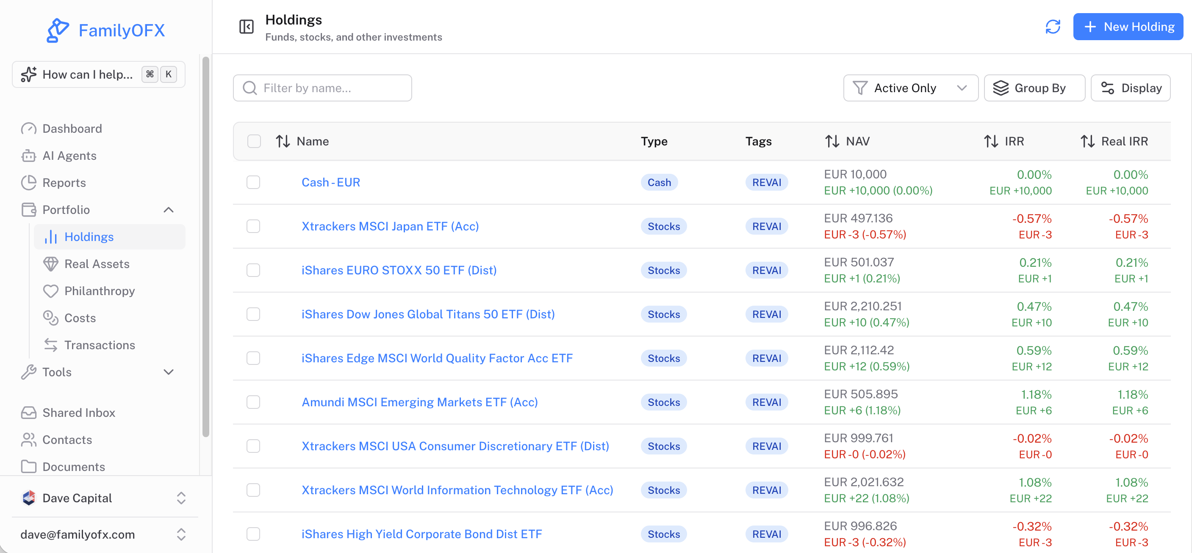



Put your constitution to work
Record each workshop's output in the FamilyOFX Constitution. Your team and the AI assistant then work from the same purpose, values and rules — every day, not once a year.
ASK THE OFFICE
Does this deal fit our constitution?
How diversified is my portfolio?
What is our cash across entities?
Holdings: NAV, IRR and real IRR across every position
Flag holdings without a recent valuation
70+
EU-built
Encrypted
secure AI tools
sovereign data options
in transit and at rest
Notes:
Bridge from the workshops to the platform: the outputs live in Org Settings → Constitution, so the AI assistant can check deals and decisions against them. Demo the holdings view if time allows.

Slide 31
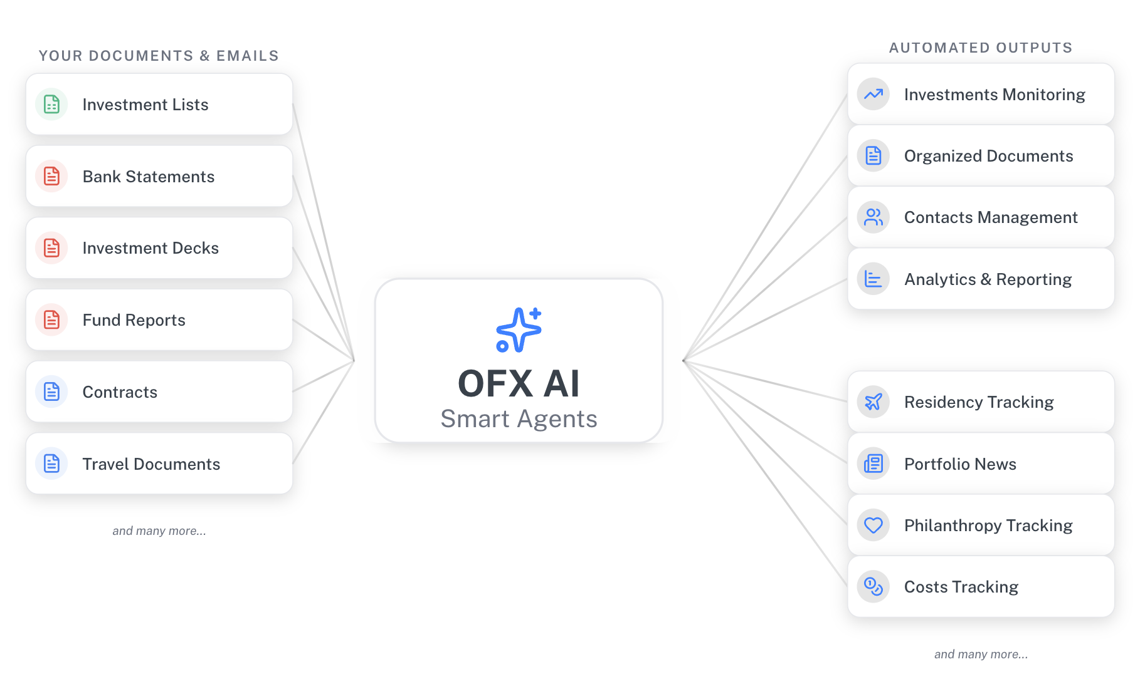




A complete family office in a box
Investment, estate and cost tracking
Allocation, liquidity and costs together; private assets kept current from your statements.
Documents tied to positions
Statements, agreements and reports attached to the investment or transaction they belong to.
A full CRM for the office
Family, operators and advisers in one relationship map, linked to deals and tasks.
Statements, decks, fund reports and contracts go in; organised positions, documents and reports come out — reviewed before anything posts.
Private by design
Role-based access, full audit trail, exports on demand. Never used for model training.
Notes:
Position FamilyOFX as one private system for investments, documents, relationships and costs. The point: you no longer need a very large fortune to run a proper office.

Slide 32



Bring clarity to how you operate
The AI system behind your family office
Single family office
Multi-family office
Small funds
One family, one workspace. Start today on published plans.
A parent office for many families, under your own brand.
Positions, CRM and operations for funds that run like a family office.
familyofx.com · etienne@familyofx.com
Notes:
Close: single family offices can sign up directly; multi-family offices and fund houses should get in touch about a parent workspace.

